Slide 1
The Patent Prior Art Finder
Developed by: Gabriel Aspir, Zach Fish, Ephraim Meiri
Mentored by: Dave Feltenberger
Summer, 2021

Slide 2

Background Information

Slide 3


First: What the heck is Prior Art?
Prior art (according to merriam-webster.com) is:
“Knowledge that is publicly available (as from the description in an already existing patent, from publications, or from public use or sale) before the date of filing a claim for a patent for an invention”
Or simply, related publications that predate your
patent.

Slide 4
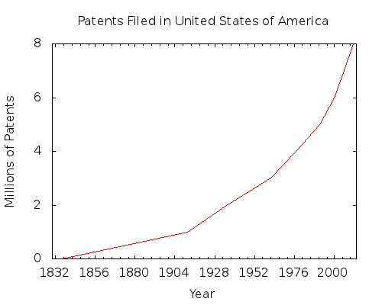

So,
Our goal was to create a Patent Prior Art Finder (PPAF) which will search through millions of patents to find the ones most similar to the user-inputted patent.

Slide 5

Q. Why would someone want to know which patents are most similar to a given patent?

Slide 6

A.This is where
comes in!

Slide 7

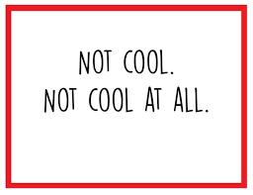

Some Answers -
To make sure that you wouldn’t get sued for patent infringement if your patent is too similar to somebody else’s, or
If you or your company are what they call “Patent Trolls”, you could use this to find out which patents are most similar to patents in a portfolio you’ve acquired, and go after the owners’ products for financial gain. (Note: please don’t do this!)

Slide 8


Some more answers -
3. You might want to cite prior art, if your work builds on top of existing technologies, or
4. If you need some good defense when being sued for patent infringement by a troll...

Slide 9
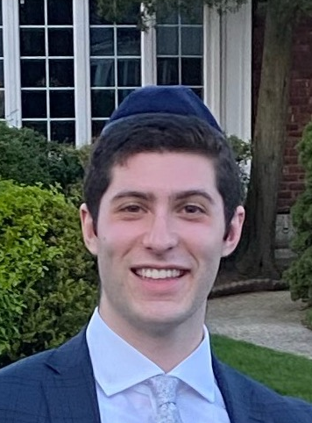
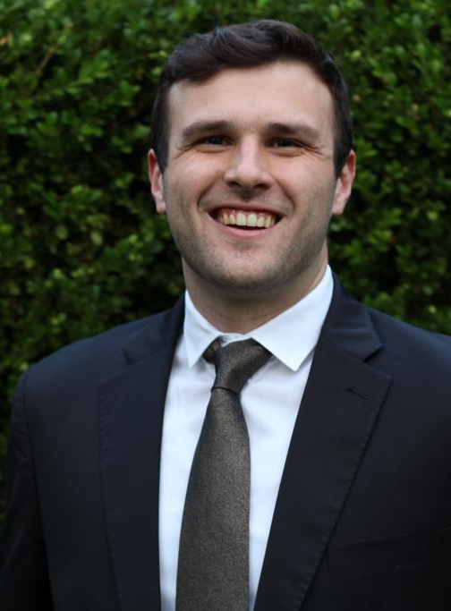
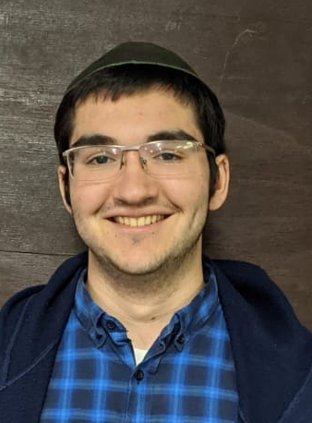
About Us:
Gabriel Aspir
Hey! I’m a rising junior at Yeshiva University and have successfully completed my first year of Computer Science courses. When I’m not coding or studying for my psych courses (my other love), I enjoy eating (who doesn’t?) and working it all off afterwards.
LinkedIn:
Gabriel Aspir
Zach Fish
I am rising junior at Yeshiva University, planning on graduating May 2023. In addition to dedicating my life at the moment to Leetcode, my hobbies include graphic design, basketball, and longboarding.
Website:
www.zachary.fish
Ephraim Meiri
Rising sophomore at YU, thankful for Java and have come to terms with all other documentation. Other interests include traditional and academic Jewish Studies. I am also an aspiring ametuer librarian and keep an eye out for interesting digital humanities projects like Dicta, Tikkoun-sofrim, and SageBook.
My LinkedIn

Slide 10
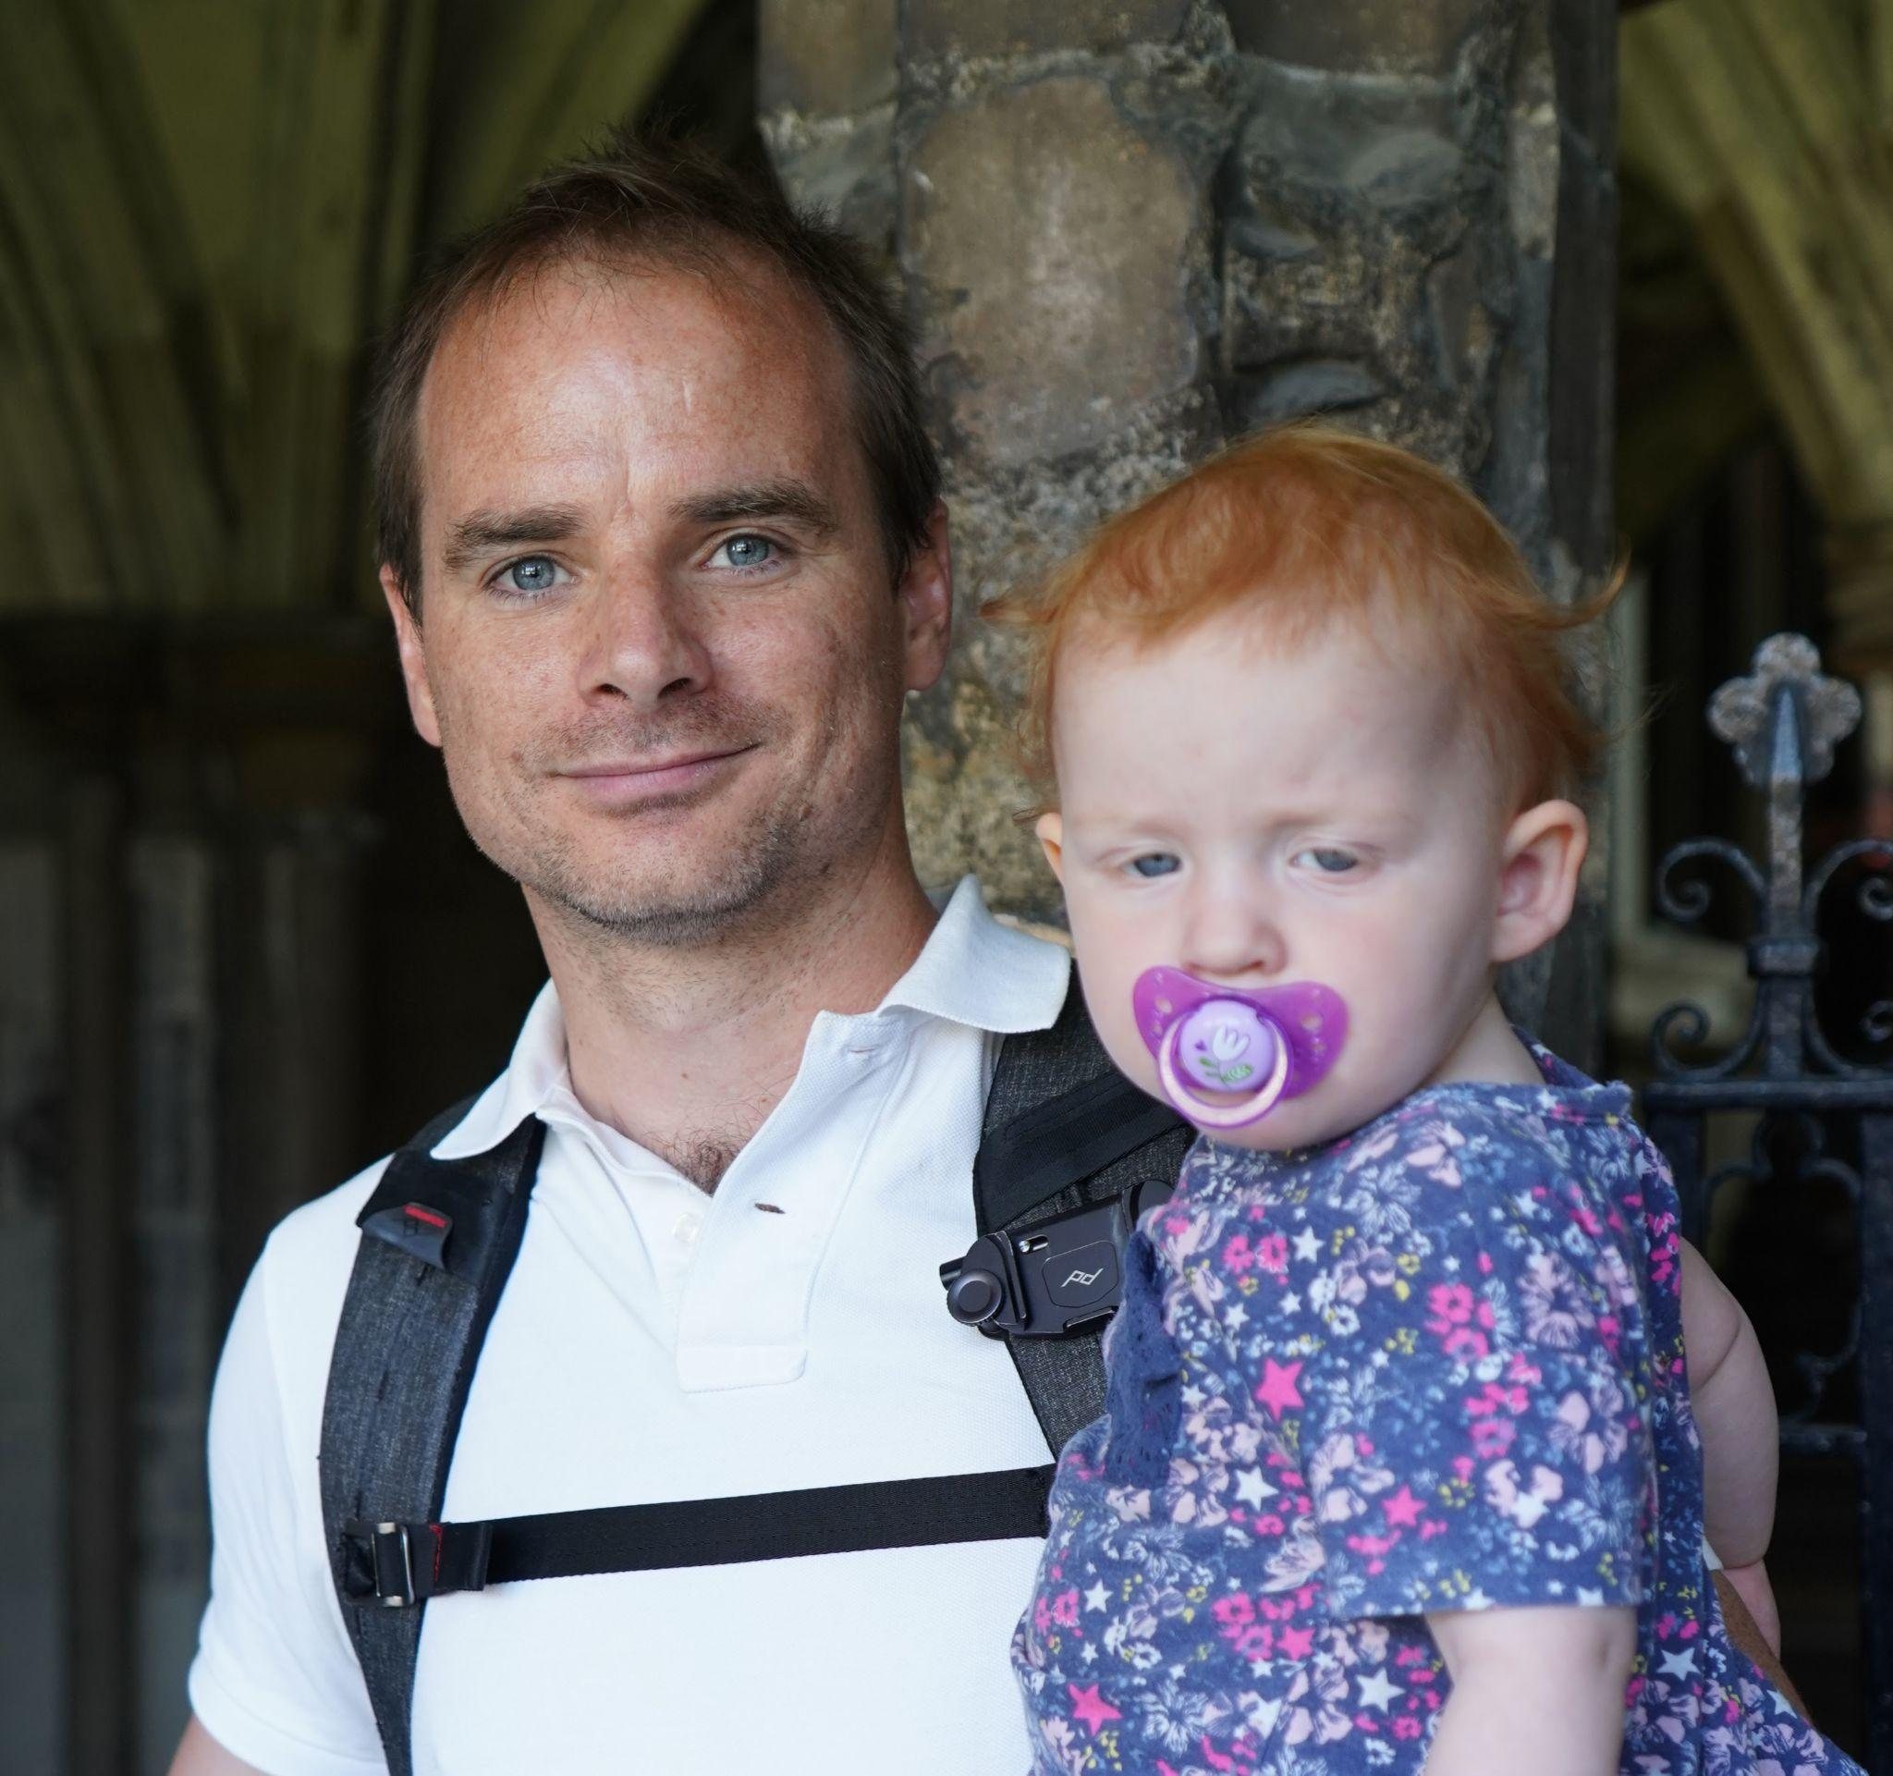
About our mentor:
Dave Feltenberger is currently a Senior Staff Software Engineer at Google and leads a group in Google Maps. He also spearheaded Google’s automated patent landscaping technology. Dave, with his industry-leading knowledge on the subject, guided us to create our very own PPAF.

Slide 11



Github URL
https://github.com/GabeAspir/Patent-Prior-Art-Finder
To access this tool for your own personal usage, clone the above github repository onto your local machine, and access the Colab Notebook entitled -
Prior_Art_Finder_Front_End.ipynb
And click on the b button at the top.

Slide 12

Colab
Prior_Art_Finder_Front_End.ipynb
The .ipynb extension stands for “ipython notebook”. There are multiple ways to access these files, such as Colab or Jupyter. We’ve chosen to use Colab as our mode of operating for its simplicity, it’s data-science driven development style, and for its heightened integration with other Google-related products.
If you’ve never used Colab notebooks before, here’s a link to get started: https://colab.research.google.com/notebooks/basic_features_overview.ipynb

Slide 13
System Features & Functionality

Slide 14
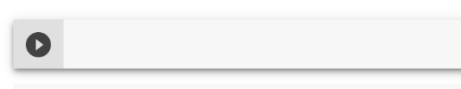
Features
To run code in Colab, all you have to do is click the little arrow next to the code block you’d like to run:
Run the first two code blocks, and complete the instructions to authenticate yourself with a gmail account.

Slide 15
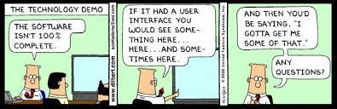
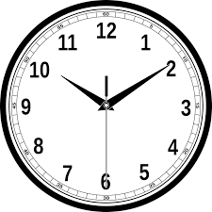
Features pt. 2
Next, there are two ways to continue from here, either put your patent against our pretrained model with 4 million patents (as our demo does),
OR, you can train your own model, just be prepared to have the program running in the background for quite some time. This will compare your patent to as many as you input.
(The Google Cloud Public Patents data set
has over 180,000,000 patents in it!)

Slide 16

Features pt. 3
If you’re using our pretrained model, insert either
A patent in the correct format, (With a full english abstract), or
A patent number corresponding to a patent in the Google Public Patent database, and click the corresponding code block.

Slide 17
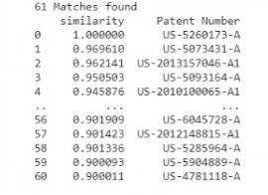
Features pt. 4
After about 20 minutes (with our pretrained 4 million patent dataset), your patent will officially have been compared to all the other ones in the dataset, and you’ll be presented
with a list of the most similar ones.
Enter the patent number of one you’d like to inspect in the next code block, and it’ll send you to its Google Public
Patent page.

Slide 18
Development

Slide 19
Roadmap of our project
Concept identification & and learning technologies
Recomposition of the code with additional libraries
We spoke to soon, #Debugging
1
3
5
2
4
6
Initial build of the code without the usage of python libraries
Incorporated Gensim into the almost finished Patent Prior Art Finder
The Patent Prior Art Finder - accessible through an Interactive Colab Notebook

Slide 20
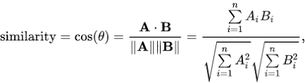
Concept identification & and learning technologies
We learnt about:
Google’s Public Patent Data Set from BigQuery.
How to pull the patent data from it using SQL
The Pandas Library
Trimming and Tokenizing the data
Different ways to represent each patent (Bag-Of-Words/TF-IDF)
Similarity techniques (Jaccard and Cosine Similarity)
Our progress is documented on our Github! https://github.com/GabeAspir/Patent-Prior-Art-Finder/tree/main/1st%20Stage%20Development

Slide 21
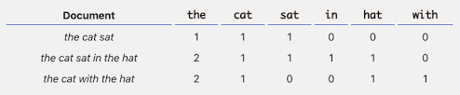
Initial build of the code without the
usage of python libraries
https://github.com/GabeAspir/Patent-Prior-Art-Finder/blob/main/Older%20Versions/_DevPatentPriorArtFinder.py
https://github.com/GabeAspir/Patent-Prior-Art-Finder/blob/main/documentation/Stage_1_Documentation_The_Official_Patent_Prior_Art_Finder.ipynb
This was our first go at comparing patents - this took just the abstracts, took out stop-words (like the word “the”), and compared patents based on the amount of times each word was present either using TF-IDF (Term Frequency- Inverse Document Frequency) or Bag-Of-Words.

Slide 22
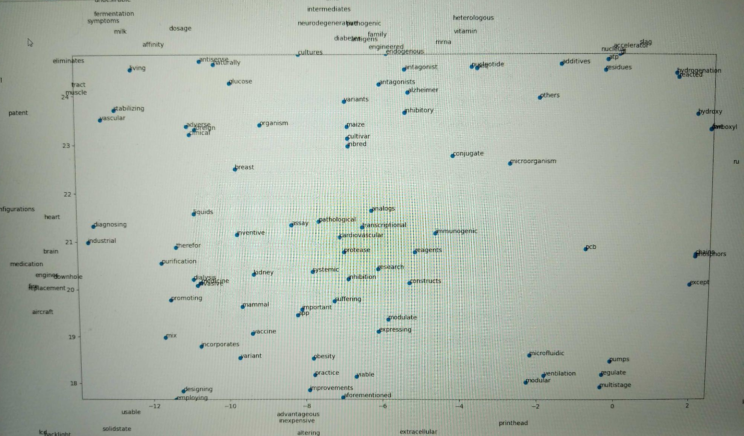
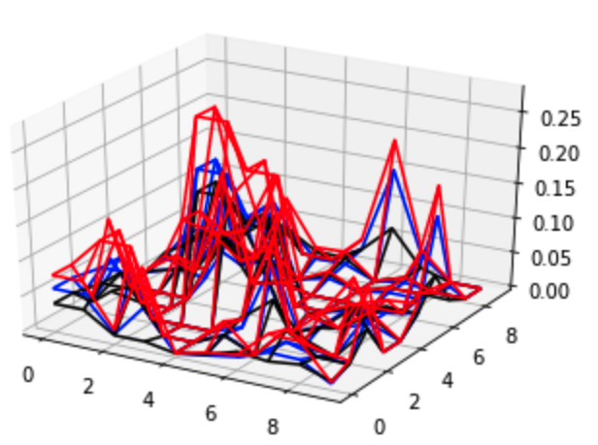
Recomposition of the code with additional libraries
https://github.com/GabeAspir/Patent-Prior-Art-Finder/blob/main/Older%20Versions/_DevNLTKPatentPriorArtFinder.py
https://github.com/GabeAspir/Patent-Prior-Art-Finder/tree/main/2nd%20Stage%20Development
We utilized NLTK, scikit-learn, and a little bit of gensim to have an improved product that worked really well with a dataset of 1010 patents. We also visualized our data in a bunch of different ways!
As an example, this is a
visualization of various Similarity
metrics across 1010 patents.
Subsection of our TSNE Graph of word vectors

Slide 23
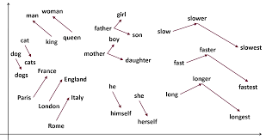
Incorporated Gensim into the almost finished Patent Prior Art Finder
There was a steep learning curve to fully understand how to utilize Gensim and the logic behind it. Yet, we now have the understandings of Natural Language Processing within Machine Learning and Artificial Intelligence.
Core Concepts — gensim - Corpus

Slide 24
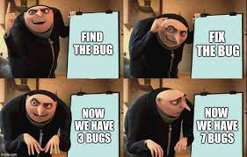

We spoke to soon, #Debugging
Of course, no development cycle is complete without a debugging stage - we spent our time making sure
Our product can run smoothly with a gigantic dataset.
The vectors were being concatenated correctly to be understood by the code.
That two patents that were deemed similar by the product were ACTUALLY similar to each other.

Slide 25
The Patent Prior Art Finder - accessible through an Interactive Colab Notebook
That’s all folks!

Slide 26
Behind The Scenes

Slide 27


Q. How can we make a computer understand our human language?
What’s the meaning of life?

Slide 28
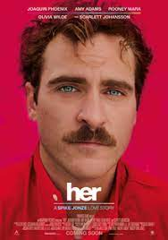
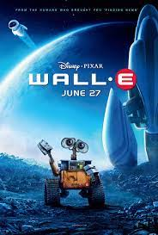
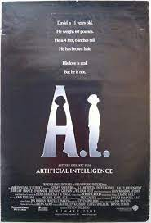
A. Through Artificial Intelligence!
Specifically, implementing NLP - or Natural Language Processing- which is a way for a computer to understand the language us humans speak.
A computer (as of 2021), will never LITERALLY understand what we’re saying (sorry sci-fi movie lovers), but through various methods, it can convert what we’re saying into something it CAN understand.

Slide 29
Python Libraries

Slide 30

Python Libraries
The language we used to build this product was Python, and we used various python libraries to help us accomplish our goal -
Pandas
SciKit-Learn
Numpy
NLTK
Gensim

Slide 31

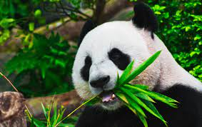
Pandas -
Pandas is a fundamental high-level building block for doing practical, real world data analysis in Python (https://pandas.pydata.org/about/)
This powerful library allowed us to visualize and perform complex data transformations and analysis on our data in the structure of a pandas Dataframe.

Slide 32

SciKit-Learn -
SciKit-Learn is a simple and efficient tools for predictive data analysis (https://scikit-learn.org/stable/index.html)
This library allowed us to apply various similarity metrics to our data, like Jaccard and Cosine Similarity Scores, at rapid speeds.

Slide 33

Numpy -
Numpy enables numerical computing with Python. (https://numpy.org/about/)
We incorporated Numpy to create the vectors that would represent our patents after passing through training.

Slide 34

NLTK -
Or Natural Language Toolkit, is the leading platform for building Python programs to work with human language data (https://www.nltk.org/)
We used NLTK, alongside our own code, to transform the patents into metadata that we can then use to calculate the similarity metrics.

Slide 35

Gensim -
Gensim is a free open-source Python library for representing documents as semantic vectors, as efficiently (computer-wise) and painlessly (human-wise) as possible. (https://radimrehurek.com/gensim/intro.html)
We implemented machine learning NLP tactics like Word2vec to represent the words, which we then used to create our “documents”

Slide 36
Want to learn more?
Feel free to reach out and connect with us on LinkedIn!
Gabriel Aspir Ephraim Meiri Zach Fish

